Slide 1

Automotive Technology: A Systems Approach, 8e
Chapter 36: Electric Vehicles
Rob Thompson and Jack Erjavec, Automotive Technology: A Systems Approach, 8th Edition. © 2025 Cengage. All Rights Reserved. May not be scanned, copied or duplicated, or posted to a publicly accessible website, in whole or in part.

Slide 2
Chapter Objectives (1 of 2)
36.01 Describe the history of electric vehicles.
36.02 Describe the major systems that make up an electric vehicle.
36.03 Describe the purpose and function of a battery control system.
36.04 Explain the differences between types of battery charging standards.
36.05 Describe some precautions that should be followed when troubleshooting and repairing an electric vehicle.

Slide 3
Chapter Objectives (2 of 2)
36.06 Describe common electric vehicle maintenance services.
36.07 Describe the basic configurations for the power train in a fuel cell vehicle.
36.08 Describe the major components of a fuel cell vehicle.

Slide 4
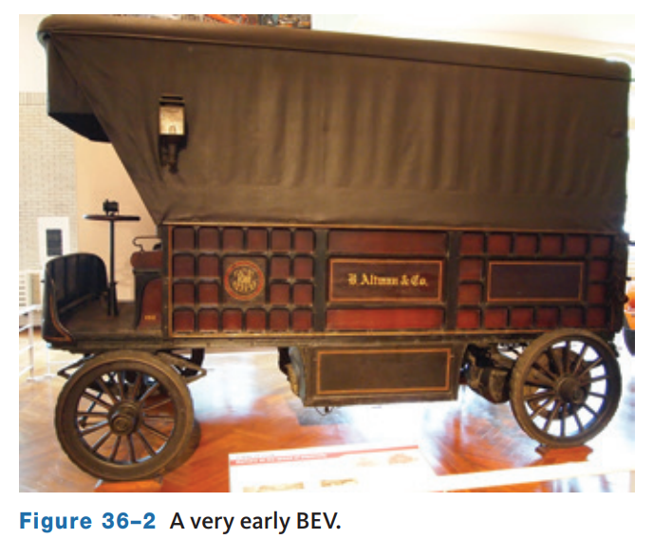
A Look at History (1 of 2)
36.01 Describe the history of electric vehicles.
Electric drive vehicles have been around for awhile.
Early automobiles were mostly electric or steam-powered.
“Steamers” were the most common until the late 1800s.
In 1900, 38 percent of the cars sold were electrically powered; the others ran on steam or gasoline.
Electric drive vehicles did not need to be manually cranked to get going and had no need for a transmission or change of gears.
These were the primary reasons the public accepted electric vehicles over gasoline.

Slide 5
A Look at History (2 of 2)
In 1865, the storage battery was invented and then further improved in 1881.
More significantly, between the years 1890 and 1910, battery technology drastically improved with the development of the modern lead-acid battery by Henri Tudor in 1881.
In 1909, Thomas Edison perfected his nickel-iron battery and marketed it to automakers, and electric vehicle popularity grew and reached its peak in 1912.
For the most part, electric drive vehicles were a thing of the past from 1935 to 1965. The
U.S. Congress introduced bills, in 1966, recommending the use of electric vehicles as a way to reduce air pollution.
In 1973, the price of gasoline drastically increased as the result of an Arab oil embargo. The rising cost led to increased attention to the development of electric drive vehicles.
In 1990, the California Air Resources Board (CARB) adopted a requirement that 10 percent of all new cars offered for sale in California in 2003 and beyond must be zero-emission vehicles (ZEVs).
In 1996, GM began to lease its EV1, the first modern electric car.

Slide 6
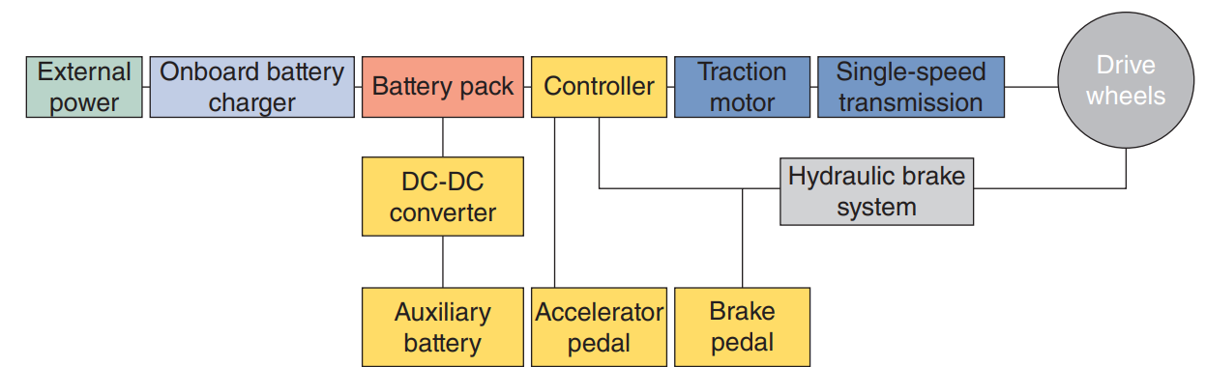
Zero-Emissions Vehicles
EVs use electrical energy stored in batteries to power the traction motors.
EVs have zero vehicle emissions.
The use of hydroelectric, wind, sunlight, or other renewable sources to generate electricity would eliminate all emissions associated with powering EVs.
Fuel cell electric vehicles (FCEVs) are also zero-emission electrically-powered vehicles, but they rely on hydrogen as the fuel.

Slide 7
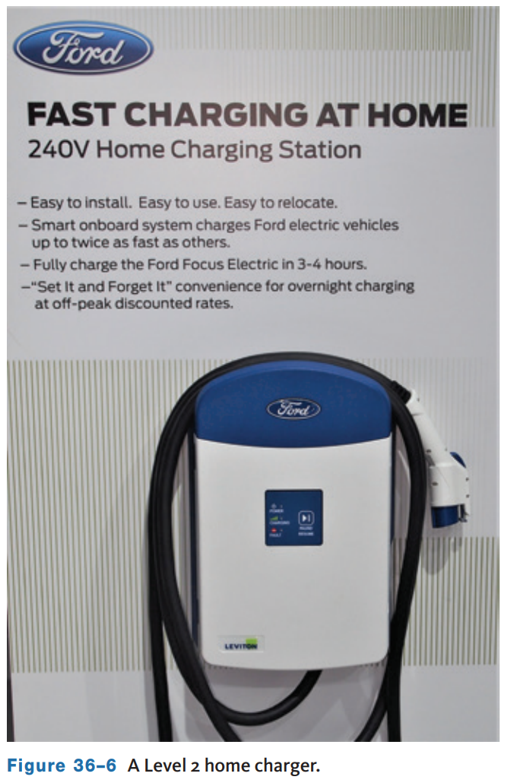
Costs
The initial cost of an EV tends to be higher than a conventional vehicle, even with tax incentives.
This is due in part to the cost of the batteries.
Current estimates put the cost of a typical new EV battery at $6,000 to $15,000.
In addition to the purchase of the vehicle, additional costs may be incurred to install an electrical outlet for charging.
Many early EVs came with a charging cord that used a standard 120-volt outlet.
While this added little or no cost for the owner to be able to plug in and charge, the low output of these chargers, between 1 and 2 kW, can make recharge times quite long.

Slide 8
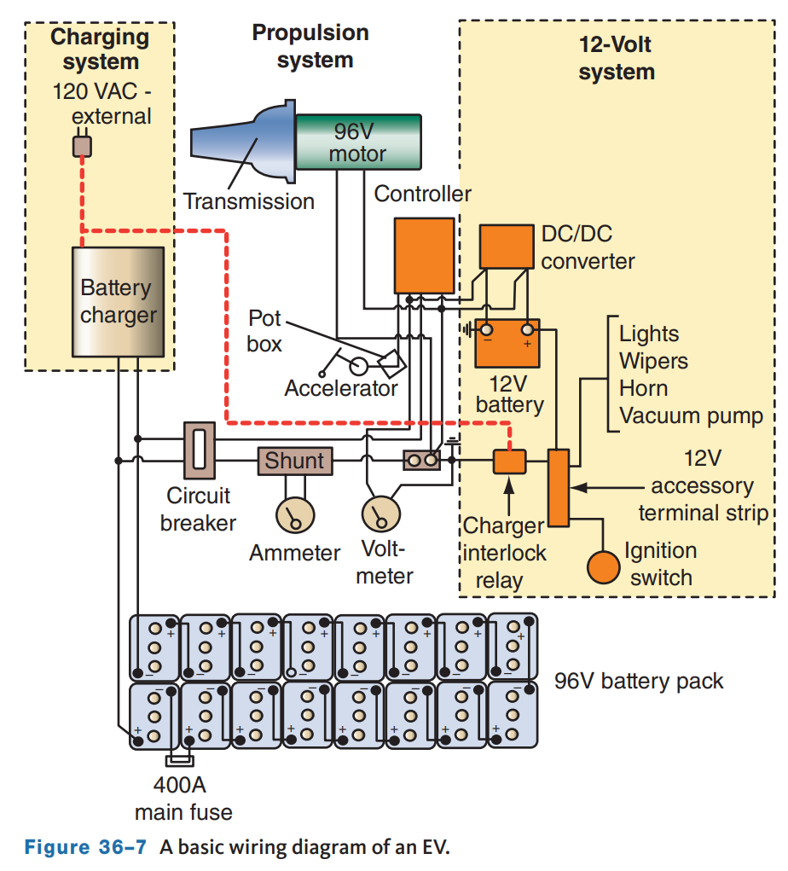
Major Parts
36.02 Describe the major systems that make up an electric vehicle.
The basic systems in an EV are a high-voltage battery pack, battery management system, the motor/generator(s) and supporting system, 12 or 16-volt (low voltage) system, converter and/or inverter, and the driver’s displays and controls.
The propulsion system has a traction motor (or two or three) that provides the power to rotate the drive wheels and a controller to control the power output of the motor.
The low-voltage system supplies the electrical power for the vehicle’s accessories, such as the radio and lights.

Slide 9
Electric Motor
In most EVs, there is no transmission because the rotary motion, or torque, of the motor can be applied directly to the axle drive gears.
A motor is capable of providing enough torque throughout its speed range to move the vehicle without torque multiplication.
With an electric motor, instant torque is available at any speed.
The entire rotational force of a motor is available the instant the accelerator pedal is pressed.
Peak torque stays nearly constant over the rpm range, and then it begins to slowly decrease.
Currently, only one EV has a multispeed transmission, the Porsche Taycan.
The Taycan has a two-speed transmission consisting of a planetary gearset and two clutches in the rear drive unit.
The configuration allows for increased performance and range.
The wide torque band eliminates the need for multi-speed transmissions.

Slide 10
Controller
The controller in an EV controls the voltage and current to the traction motor(s) in response to the driver’s input.
The controller can reverse the current flow to the motor when reverse gear is selected.
In electric vehicles with DC motors, a simple variable-resistor-type controller can be used to regulate the speed of the motor.
With this type of controller, full current and power is always drawn from the battery.
At slow speeds, when full power is not needed, a high resistance in the resistor reduces current flow to the motor.
With this type of system, a large percentage of the energy from the battery is wasted as an energy loss (heat) at the resistor.
High speeds are the only time all of the available power is used.
Modern controllers for AC motors adjust motor speed through pulse width modulation (PWM).
Pulse width is the length of time, in milliseconds, that a component is energized.

Slide 11
Inverter/Converter
Remember, a storage battery holds only DC voltage.
An AC power inverter converts the battery’s DC voltage into three-phase AC voltage to power the traction motor.
The output voltage varies according to the demands of the driver and the vehicle.
Normally, the inverter is controlled by an electronic control module.
The output from a typical inverter is constantly being calculated using input signals from the accelerator pedal, the motor’s shaft speed sensor, the motor’s direction sensor, and the brake pedal.
The inverter is liquid-cooled, and the heat from the inverter can be used to supplement the passenger compartment’s heater to save energy.
This is done automatically whenever the controls are set for heat.

Slide 12
Knowledge Check (1 of 2)
How is the EV inverter cooled?

Slide 13
Knowledge Check Answer (1 of 2)
  Answer: The inverter is liquid-cooled.

Slide 14
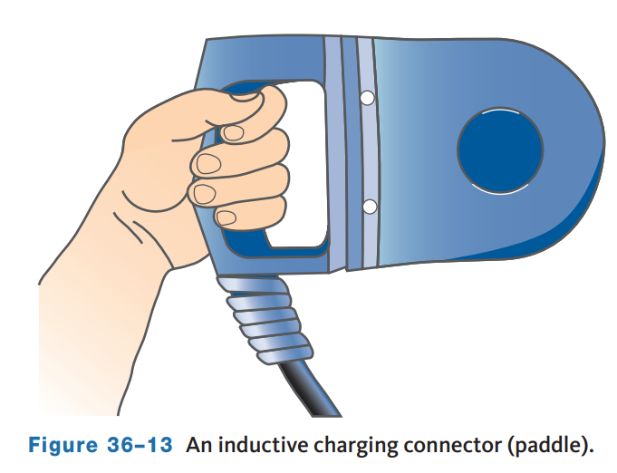
Charger to Vehicle Connectors
There are two ways an EV is connected to an external source of electricity for charging.
One is called a conductive coupling.
The coupling is plugged into a receptacle on the vehicle where it connects into the wiring for the batteries.
The other is called inductive coupling.
Small-scale inductive charging is available in many vehicles to charge cell phones.
Inductive charging transfers electricity from a charger to the vehicle using magnetic principles.
To charge the batteries, a weatherproof paddle is inserted into the vehicle’s charge port.

Slide 15
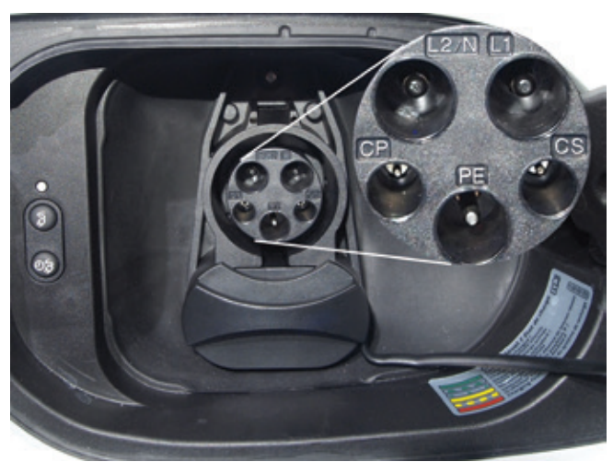
Recharging Standards and Regulations
The most recognized standard is the North American standard for electrical connectors for electric vehicles as defined by the Society of Automotive Engineers (SAE).
This standard is known as the “SAE Surface Vehicle Recommended Practice J-1772, SAE Electric Vehicle Conductive Charge Coupler.”
Basically, this standard covers the physical, electrical, communication protocol, and performance requirements for an EV’s conductive charge system and coupler.
The purpose of the standard is to ensure EVs from different manufacturers will not need special or unique chargers or charging connectors.

Slide 16
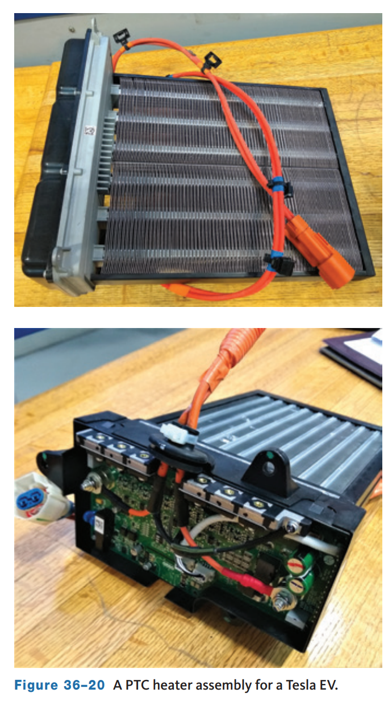
HVAC
To meet federal safety standards, all vehicles must be equipped with passenger compartment heating and windshield defrosting systems.
Vehicles with an internal combustion engine use the heat of the engine’s coolant to warm the passenger compartment and the air conditioning system to cool the passenger compartment.
With EVs, the HVAC system is combined into a larger thermal management system. Common on EVs is an electric resistance heater with a fan, usually a positive temperature coefficient (PTC) heater.

Slide 17
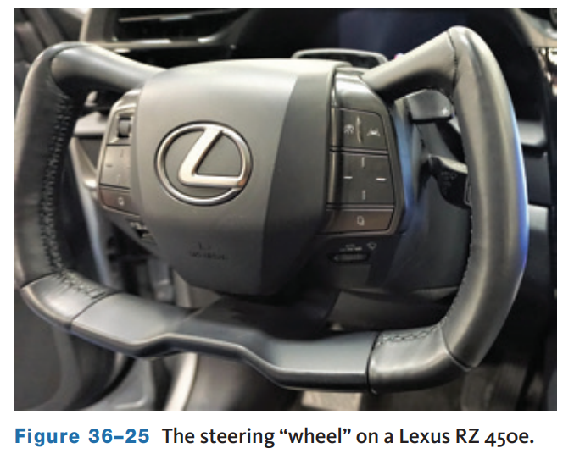
Driving an EV
Driving an EV is like driving any other vehicle but with some notable exceptions.
There is still a steering wheel, although wheel may not be the correct word for some vehicles, a brake pedal, and an accelerator pedal.
The biggest difference for the driver is that attention must be paid to the consumption of energy.
If the batteries are not charged, the vehicle will not move.
EVs run silently, and this has been a concern since pedestrians cannot hear an approaching EV.

Slide 18
Precautions
36.05 Describe some precautions that should be followed when troubleshooting and repairing an electric vehicle.
During diagnosis and repair of an EV, always keep in mind that the vehicle has very high voltage.
This voltage can kill you!
Therefore, always adhere to the safety guidelines given by the manufacturer.
Keep in mind the same concerns stated in the chapters dealing with any high-voltage system should be adhered to now.
Repairs to the high-voltage systems should only be performed by technicians trained and certified for working on these systems.

Slide 19
EV Maintenance and Repair
36.06 Describe common electric vehicle maintenance services.
As long as there are moving parts on our vehicles, there will be some type of maintenance and repair work to be performed.
And while EVs tend to have fewer maintenance items compared to ICE vehicles, they are not completely maintenance free yet.
Many current electric vehicles are based on standard ICE models, which reduces development and production costs.
As such, the EV and ICE models share many design features and components, making routine maintenance easier and mostly the same.
However, there can be important differences, which is why proper training and access to the manufacturers service information is critical when working on these vehicles.

Slide 20
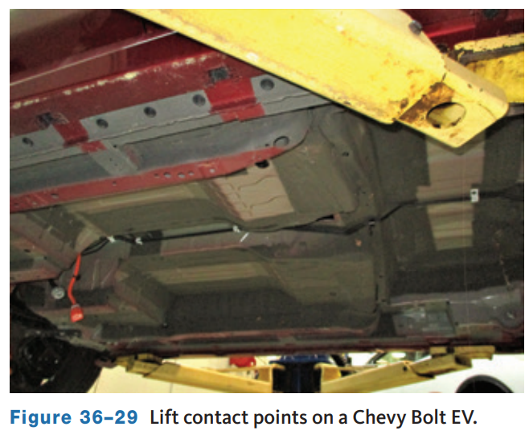
Lifting and Inspection
36.05 Describe some precautions that should be followed when troubleshooting and repairing an electric vehicle.
Before attempting to lift an EV on a hoist, make sure you have the correct lifting information, and if necessary, proper adaptors to safely lift the vehicle.
Since most EVs house the battery packs along the bottom of the vehicle, lift contact points must be placed precisely to avoid damage to the battery.
When working on some Tesla models, raising the vehicle requires a special hoist contact adaptor.

Slide 21
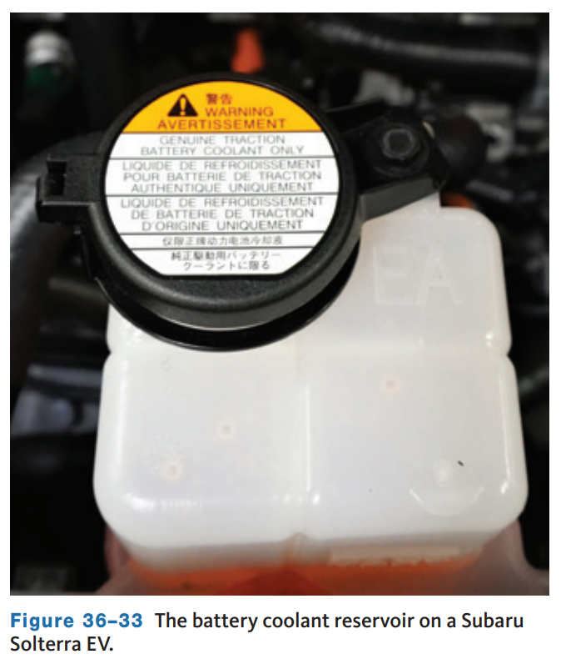
Cooling System Service
Most manufacturers recommend replacing the coolant every 4 to 5 years.
Replacing the coolant on many EVs will require some special tools and procedures, a vacuum filling system, and a scan tool to properly refill and bleed all air from the system.
Air trapped in the system can lead to costly damage to the high-voltage batteries and inverters.
Attempting to service the cooling system on an EV without the correct tools, particularly a scan tool capable of performing the necessary functions, can result in serious damage.

Slide 22
HVAC Maintenance
In addition to cabin filter replacements, some EVs have replaceable A/C desiccant bags.
Tesla recommends replacing the desiccant bag every 4 years on their vehicles.
To replace the desiccant, discharge and evacuate the A/C system.
Remove the cap from the accumulator and the snap ring retainer.
Remove the desiccant bag and determine the amount of oil that needs to be replaced by weighing the used bag.
Install the new bag, cover, and snap ring. Evacuate the system and perform a leak test.
Once the leak test is complete, remove the low side hose from the super manifold.
The super manifold is a multifunction heat exchanger between the A/C and cooling system on Tesla vehicles. Inject oil back into the system.
The amount of oil is based on the weight of the old desiccant bag and the weight of the replacement bag.
Recharge the A/C system and perform the Thermal Performance self-test.

Slide 23
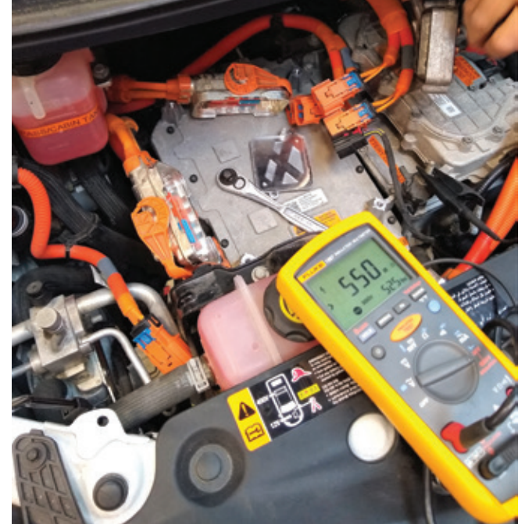
Drive System Service
On-vehicle tests of the electric drive system are necessary when DTCs indicate faults with the high-voltage system or components.
These tests include performing high-voltage cable insulation tests and motor/generator winding checks.
Testing the high-voltage cables requires a resistance tester.
Any damage or breakdown of the insulating layers of these cables will result in high-voltage isolation codes.
The insulation tester generates a high-voltage pulse through the cable to check for leaks in the insulation.

Slide 24
Discussion
And while EVs tend to have fewer maintenance items compared to ICE vehicles, they are not completely maintenance free yet.
Have a class discussion about the maintenance items discussed and required on EV’s compared to ICE vehicles.

Slide 25
Fuel Cell Vehicles
Fuel cell electric vehicles (FCEV) are the result of many years of research and development on electric and hybrid vehicles.
They share many of the same technologies but differ greatly in the source of energy used to power the electric motors that are used to move the vehicle.
Although the U.S. Department of Energy has announced that it will no longer fund fuel cell research and development, the manufacturers who have been exploring the possibilities say they will continue.
A fuel cell vehicle is much like a battery-operated electric vehicle.
It operates like one and has many of the same characteristics: Electricity powers a motor to drive the vehicle, the vehicle operates very quietly, and the output of CO₂ and other harmful emissions is zero.
FCEVs have electric motors, but the immediate energy source for those motors is not necessarily batteries.
Some FCEVs use an ultra-capacitor in place of a battery pack.

Slide 26
Hydrogen
Fuel cell vehicles use hydrogen as their fuel or energy source. Hydrogen is only found in compound form, such as in water, which is a combination of hydrogen and oxygen.
Fossil fuels are combinations of carbon and hydrogen, which is why they are called hydrocarbons. Due to its atomic structure, hydrogen is full of energy and is used to make reformulated gasoline, ammonia for fertilizer, and many different food products.
Hydrogen contains more energy per weight than any other fuel, but contains much less energy by volume.
The auto industry has long used the energy released by separating hydrogen from a substance and recombining it with oxygen for many years.
In a gasoline-fueled engine, gasoline is forced (by heat) to combine with oxygen.
The result is combustion, which releases energy.
That energy is used as mechanical energy.
In a fuel cell, the same basic thing happens, but the chemical energy is released as electrical energy.

Slide 27
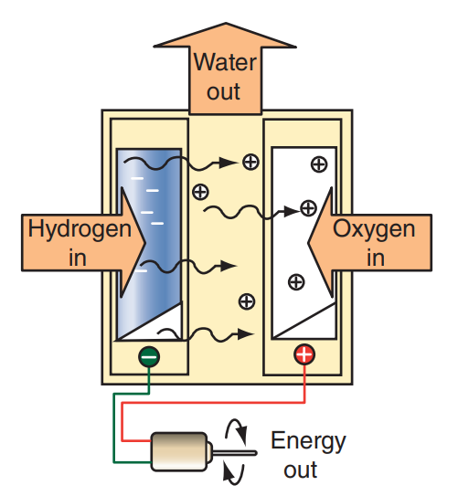
Fuel Cells
A fuel cell produces electricity through an electrochemical reaction that combines hydrogen and oxygen to form water.
The basic principle of operation is the opposite of electrolysis.
In a fuel cell, catalysts are used to combine the fuel (hydrogen) with oxygen.
The reaction releases electrons.
A single fuel cell produces very low voltage, normally less than 1 volt.
To provide the amount of power needed to propel a vehicle, several hundred fuel cells are connected in series.
This assembly is the fuel cell stack.

Slide 28
FCEV Configurations
36.07 Describe the basic configurations for the power train in a fuel cell vehicle.
There are three basic configurations that describe the design of an FCEV powertrain.
When the powertrain has a direct-supply system, the energy from the fuel cell is delivered directly to the electric traction motor(s).
With this configuration, the FCEV cannot have regenerative braking and propulsion power depends entirely on the output of the fuel cell.
In a battery hybrid powertrain system, the energy from the fuel cell is sent to the motor(s), the battery pack, or both.
This configuration can use regenerative braking.
The battery can also supplement the fuel cell’s energy to improve performance.
This system requires more electronic controls than the direct-supply system.
The third configuration uses ultra-capacitors rather than a battery.
The ultra-capacitors are charged by the fuel cell and regenerative braking.
Ultra-capacitors charge and discharge quickly, which allows the powertrain to respond quicker to changing conditions.

Slide 29
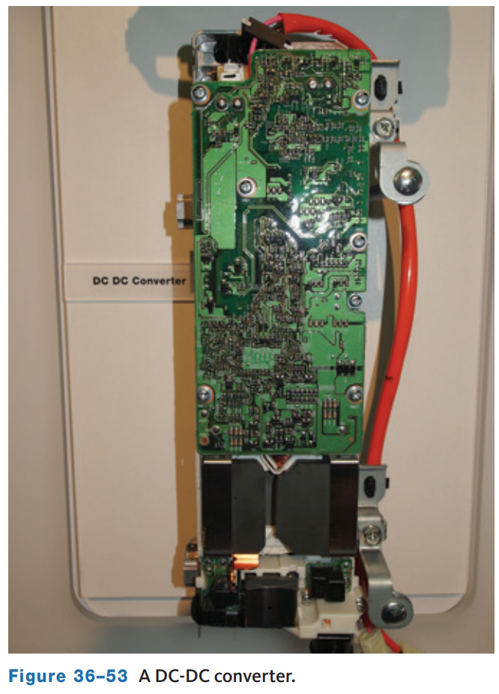
Controls
To control the output of a fuel cell and therefore the speed of the vehicle, advanced electronics are necessary.
FCEVs have high- and low-voltage systems, and electronic controls are necessary to allow the fuel cell to power both.
This means that all FCEVs need a DC-DC converter to reduce the high-voltage from the fuel cell.
These controls are in addition to the typical computer systems of other vehicle types.
However, since a fuel cell generates DC voltage, an inverter is not needed unless the traction motors and the accessories require AC voltage.

Slide 30
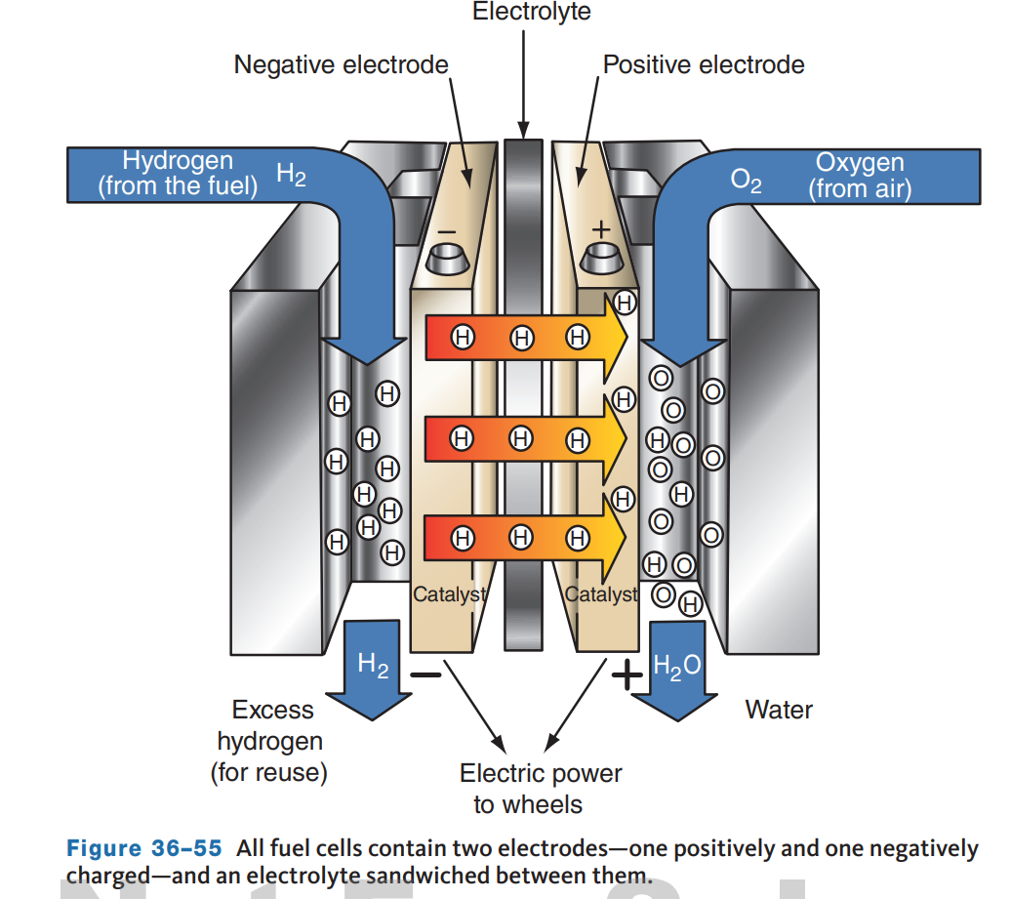
Fuel Cell Types
36.08 Describe the major components of a fuel cell vehicle.
The different types of fuel cells vary by size, weight, fuel, cost, and operating temperature.
Regardless of design, all fuel cells have two electrodes coated with a catalyst.
The catalyst, normally platinum, on the electrodes causes the chemical reaction in the fuel cell.
One of the electrodes has a positive polarity, the anode, and the other is negative, the cathode.
The electrodes are separated from each other by an electrolyte and separators.

Slide 31
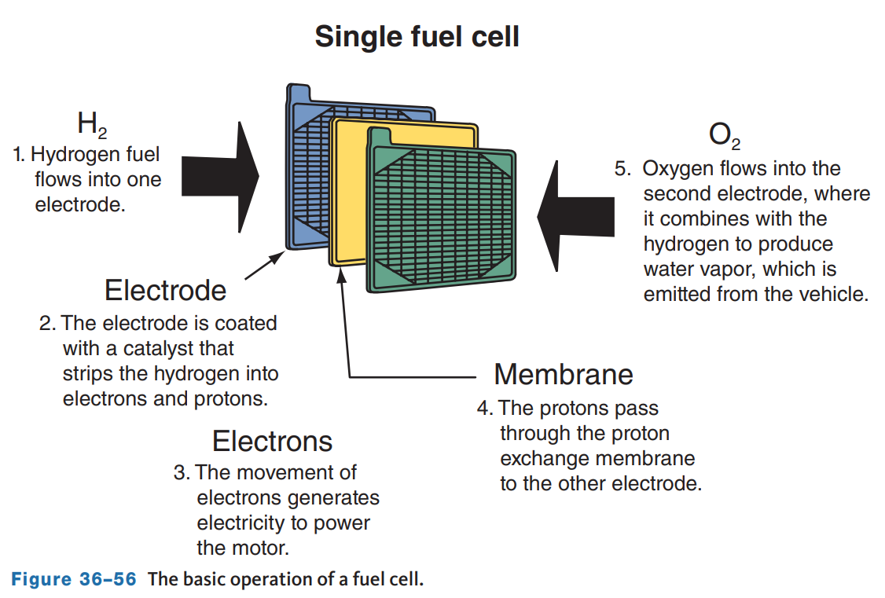
Proton Exchange Membrane Fuel Cell
The proton exchange membrane (PEM) fuel cell, or derivatives of it, is a favored design for use in vehicles because it allows for adjustable outputs which are necessary for driving.
The speed of the vehicle can be controlled by controlling the output of the fuel cell.
Although it is quite compact, it is capable of providing high outputs.
When compared to other fuel cell designs, it is most efficient at relatively low temperatures of 86–212 °F (30–100 °C).
However, it is expensive to manufacture.

Slide 32
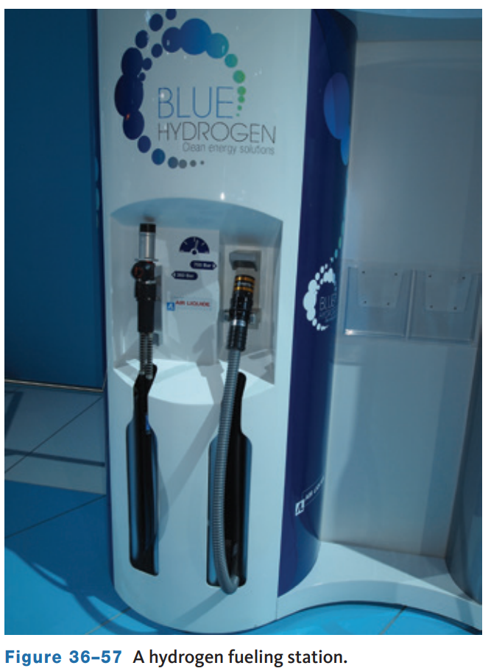
Hydrogen Fueling Infrastructure
Until there is a well-established distribution system for hydrogen, FCEVs will not be a dominant source of transportation.
However, there are many companies trying to establish hydrogen fueling stations.
In the United States, there are more than 50 refueling stations available, and this is not enough to sustain the growth of fuel cell vehicles.
These stations will look like normal gas pumps; however, the car’s filler neck is very different as is the fuel nozzle.

Slide 33
Current FCEVs
Mass market fuel cell vehicles for everyday use are still years away; however, there are nearly 15,000 FCEVs operating in select U.S. markets.
Three fuel cell-powered models, the Toyota Mirai, Honda Clarity FC, and Kia Nexo, have been available for lease or sale since 2015.
All of these are part of the ongoing research that is taking place.

Slide 34
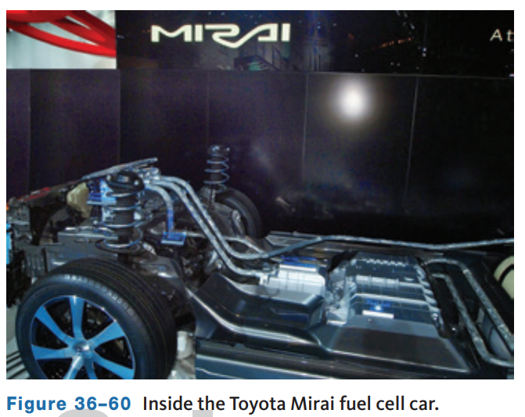
Toyota
To take a look at how hybrid technology and components are used in a fuel cell vehicle, consider one of their latest FCEV, the Mirai.
The vehicle is a battery hybrid FCEV and is propelled by 182 hp (135 kW) electric motors.
The compressed fuel is stored in four hydrogen fuel tanks at 10,000 psi (700 kg/cm).
The battery and associated electronics are also similar to those found in the Prius.

Slide 35
Honda
Honda recently discontinued their fuel cell car, called the Clarity FCV, which was available for lease in select California locations.
Honda is planning to return to the FC market in 2024 with a CR-V FC vehicle codeveloped with General Motors.
The fuel cell of the Clarity is under the hood, and the voltage-control unit sits on top of the FC.
The control unit boosts and regulates the power produced by the FC.
An air compressor increases airflow into the stack, which also increase power output.
The AC synchronous electric motor is rated at 174 hp and is connected directly to a transmission.
A 1.7 kWh Li-ion battery pack is mounted below the front seats and acts as a buffer for the fuel cell and provides extra power during heavy loads.

Slide 36
Kia
Kia currently offers the Nexo fuel cell vehicle in select California markets.
The Nexo has a range of up to 380 miles using a 95-kWh fuel cell stack and a 40-kWh battery driving an electric motor rated at 161 hp.
A base price of $60,135 is offset by $15,000 in hydrogen fuel cards good for 6 six years after purchase or 3 years for a lease.

Slide 37
Knowledge Check (2 of 2)
Most hydrogen fuel cell vehicles are only being offered for sale or lease in one U.S. state. Which state?

Slide 38
Knowledge Check Answer (2 of 2)
Answer: California

Slide 39
Chapter Reflection
Please take a moment to compare your perception electric vehicles before and after you studied this chapter. Then respond to the following questions in one or two paragraphs. Use 150–200 words in your reflection.
Did anything in this chapter change your thinking about electric vehicles? Describe which parts or details of EV’s interest you most.
Considering all you have learned, do you prepared to perform service on an EV? How will you ensure you are prepared?

